Slide 1
Stock Price Prediction
BY
Hasan Asif
Hussain Vakharwala
Rajeev Ramesh

Slide 2
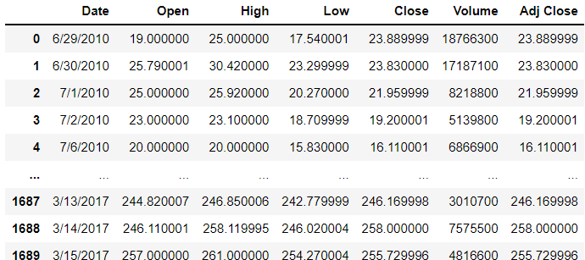
Introduction
In this project we try to predict the stock prices using Ensemble technique and RNN. In this Data many different prices for a particular stock are given, which we have used as a feature to train the model.

Slide 3
Importance
Help financial institution to make decision.
Help individua to create wealth.
Serve as an indicator of the state of economy.

Slide 4
Workflow
First, we collected the dataset using an API for Tesla stocks.
Next step includes Data preprocessing and feature scaling
Then, Segregating data into train test split very crucial in Time-series data.
Then, We setup up the LSTM RNN model for future prediction.
Finally, the prediction on the Test set and hyper-Parameter tuning.

Slide 5
Train Test Data
Before Transformation
Train_data= 1184 records
Test_data= 508
After Transformation
X_train= (1184,50,1 ) X_test=(508,50,1)
Y_train= (1184,1) Y_test=(508,1)

Slide 6
Data Transformation
X_train Y_tain
Train[0:50] Train[51]
Train[1:51] Train[52]
Train[2:52] Train[53]
.
.
.
Same transformation done with the test data.

Slide 7
Challenges
We have faced two main challenges while doing this project

Slide 8
Challenge 1
Splitting the data in train test. As this is a time-series problem next data depended on the previous data so we can not simply divide the data using random sample.
We have build the train dataset by selecting sample from starting to a certain date and then continues from date to the end to build the test data.

Slide 9
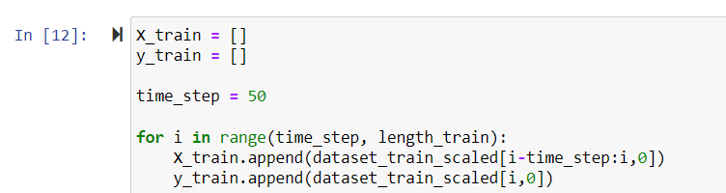
Code of Train-Test Split

Slide 10
Challenge 2
Deep learning models are very sensitive to the scaling. So, train and test data needs to be scaled before passing to the model.
RNN and LSTM converge faster when we provide the scaled the and better accuracy.
To achieve scaling, we have used MinMax scaling and scaled the data between 0 and 1.

Slide 11
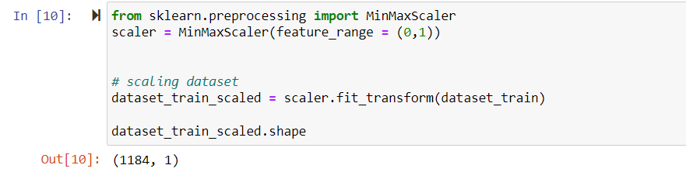
Code of Scaling

Slide 12
Model Generation
Here comes the most magical part.
We have used the RNN for this prediction
RNNs can use their internal state (memory) to process sequences of inputs. This makes them applicable to tasks such as unsegmented, connected handwriting recognition or speech recognition. In other neural networks, all the inputs are independent of each other. But in RNN, all the inputs are related to previous output.

Slide 13
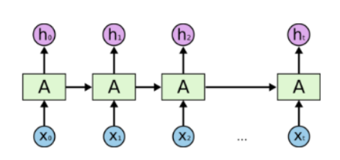
RNN Working
First, it takes the X(0) from the sequence of input and then it outputs h(0) which together with X(1) is the input for the next step. So, the h(0) and X(1) is the input for the next step. Similarly, h(1) from the next is the input with X(2) for the next step and so on. This way, it keeps remembering the context while training.

Slide 14
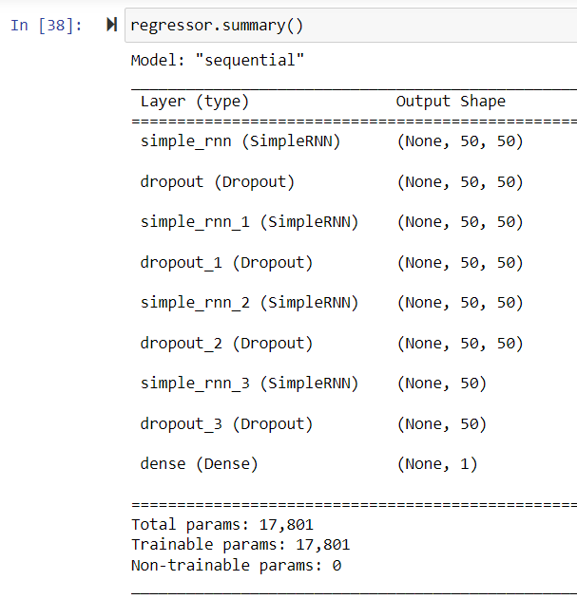
OUR Model
We have created 4 layer RNN with .2 dropout after every layer. For compilation, I have used Adam and for loss function Mean Squared Error, over 50 Epochs and batch size of 32.

Slide 15
Hyper-Parameter Tuning
We have tuned the RNN model on many parameters but the significant change was seen on Batch size and Dropout.
Batch size-
Dropout-

Slide 16
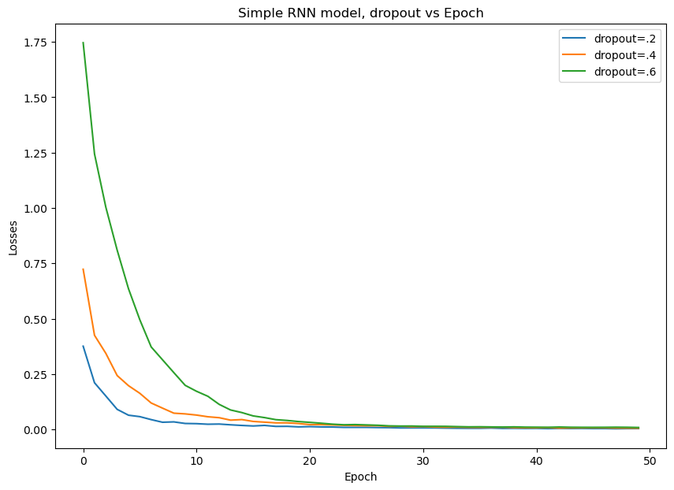
Dropout Vs Loss
As the dropout increase model start generalizing and loss increases in the starting and model converge late.

Slide 17
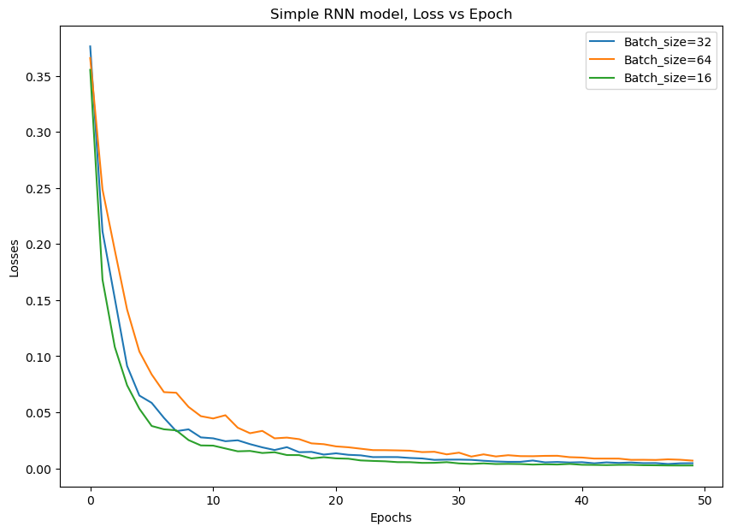
Batch Size vs Loss
We have noticed that lower the batch size, better the convergence but as we lower the batch size from 64 to 16 150% increase in the training time .

Slide 18
Models Performance
LSTM performed better than the simpleRNN due to better memorization of the previous data.
Model | Error | Value
LSTM | Train MSE | 119.185
 | Test MSE | 220.192
RNN | Train MSE | 242.331
 | Test MSE | 228.54

Slide 19
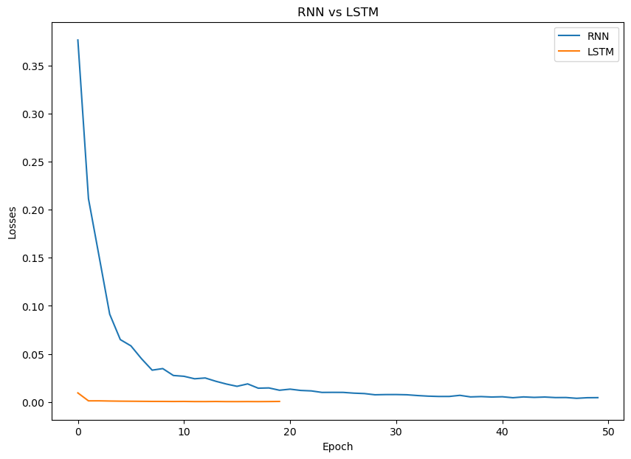
LSTM vs RNN
LSTM model converge quite quickly and have a very low Training error but its overfitting on test set.

Slide 20
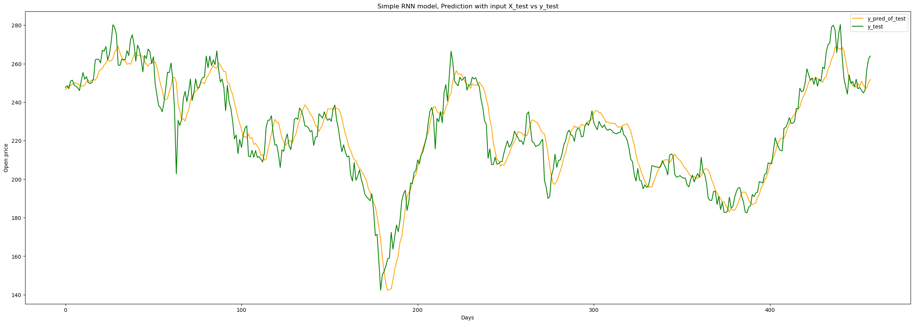
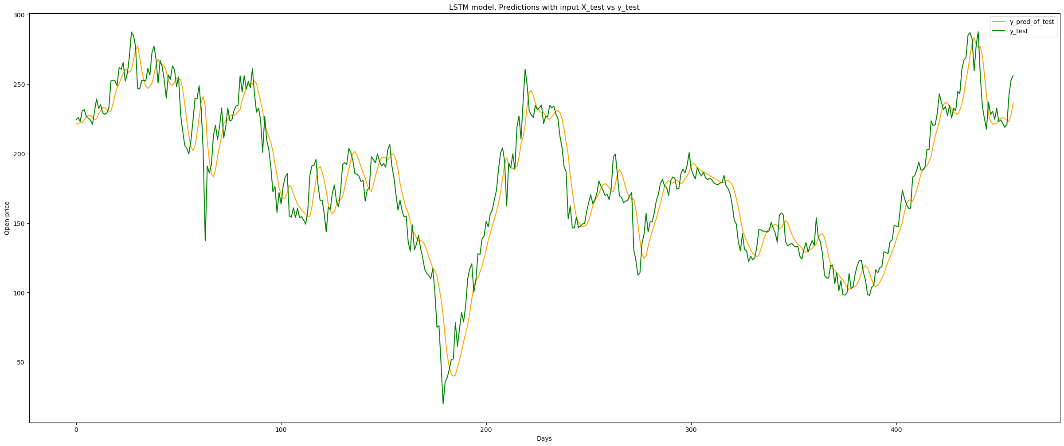
Test Output

Slide 21
